Slide 1
Evidence for Evolution Notes that go along with Pages 151 through 163 in Cells and Heredity Book
Ms. Aeschlimann
2013

Slide 2
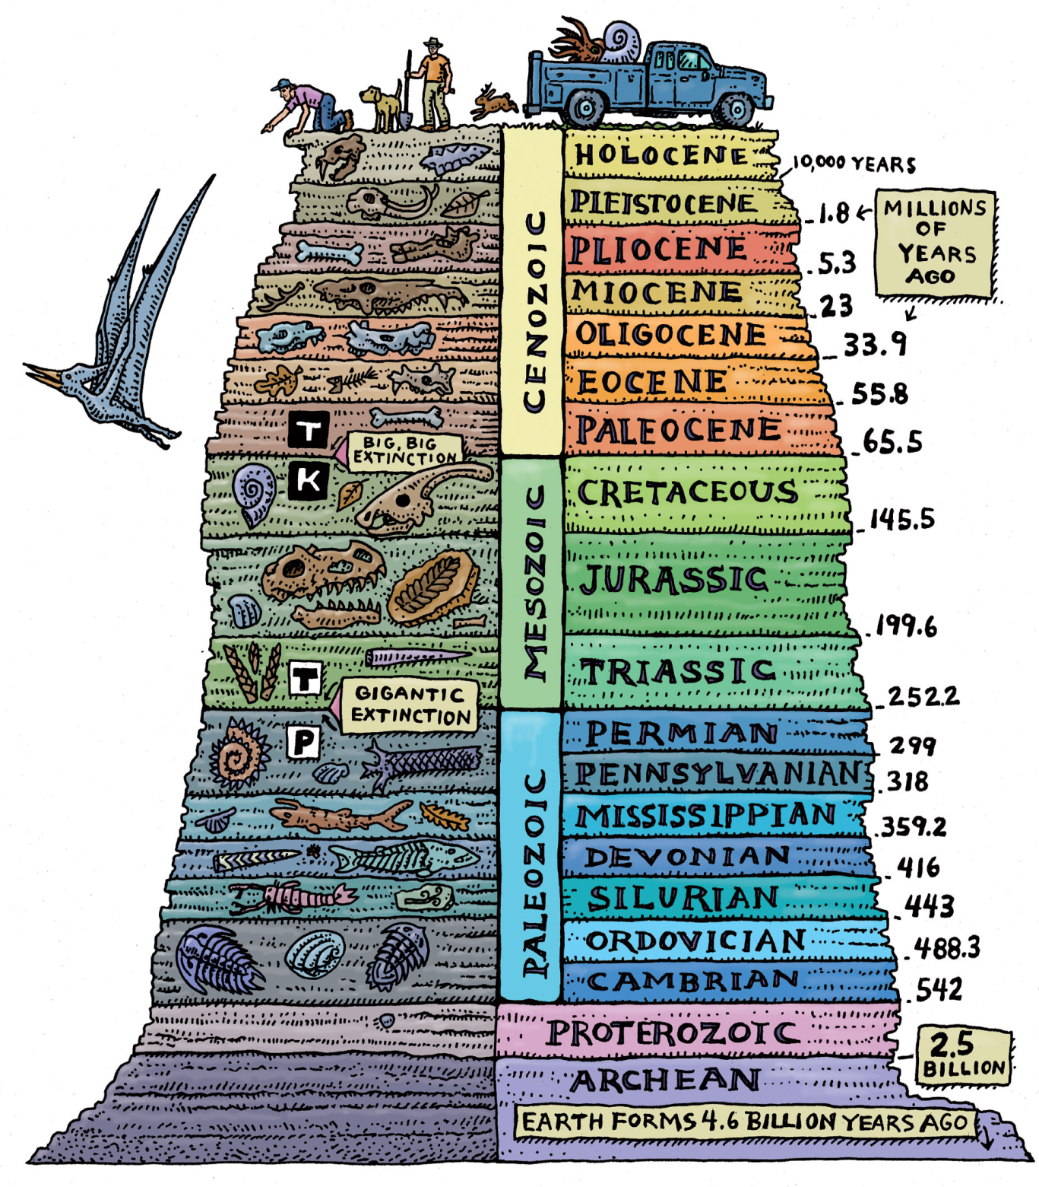
Do Now
How can fossils give us evidence for Evolution?
Today we will:
Watch a Brainpop on Human Evolution and the Fossil Record
Finish the Fossil Notes in the book from yesterday

Slide 3
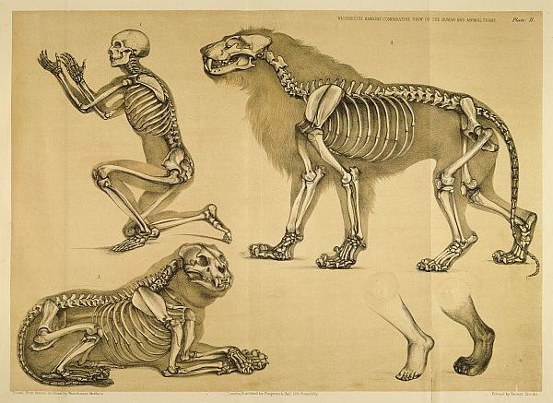
Do Now
Take out your Brainpop Notes from Friday on Human Evolution
Today we will:
Take notes on evidence for evolution…

Slide 4
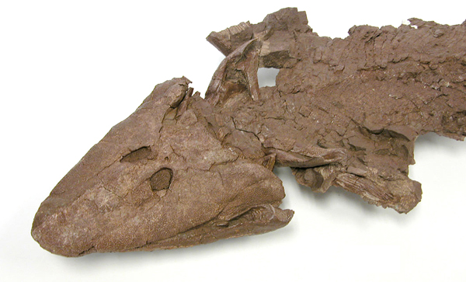
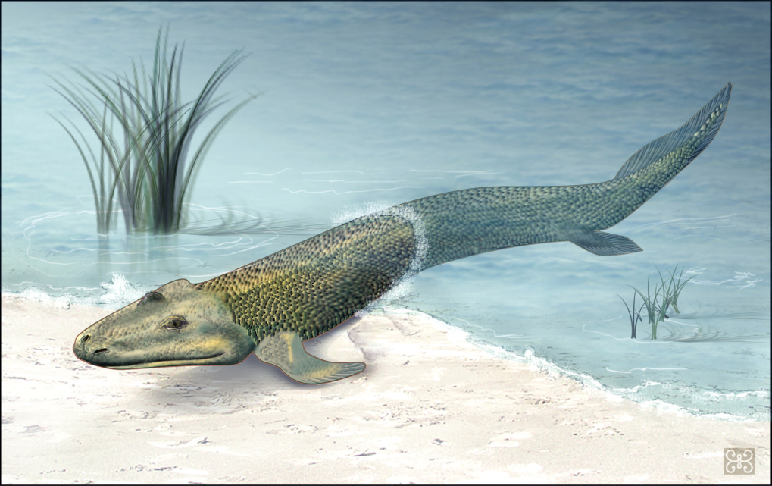
Do Now
In 2006, scientists discovered fossilized skeletons of a fish with VERY interesting features.
Fossil evidence showed that the animal not only had scales, fins, and gills, but also had lungs, a full set of ribs, and limb bones arranged to support the animal’s weight.
Question:
Why do you think that the Tiktaalik fossils are an important piece of evidence for evolution?
Take out ALL Evolution Notes and have a copy of the yellow Cells and Heredity book

Slide 7
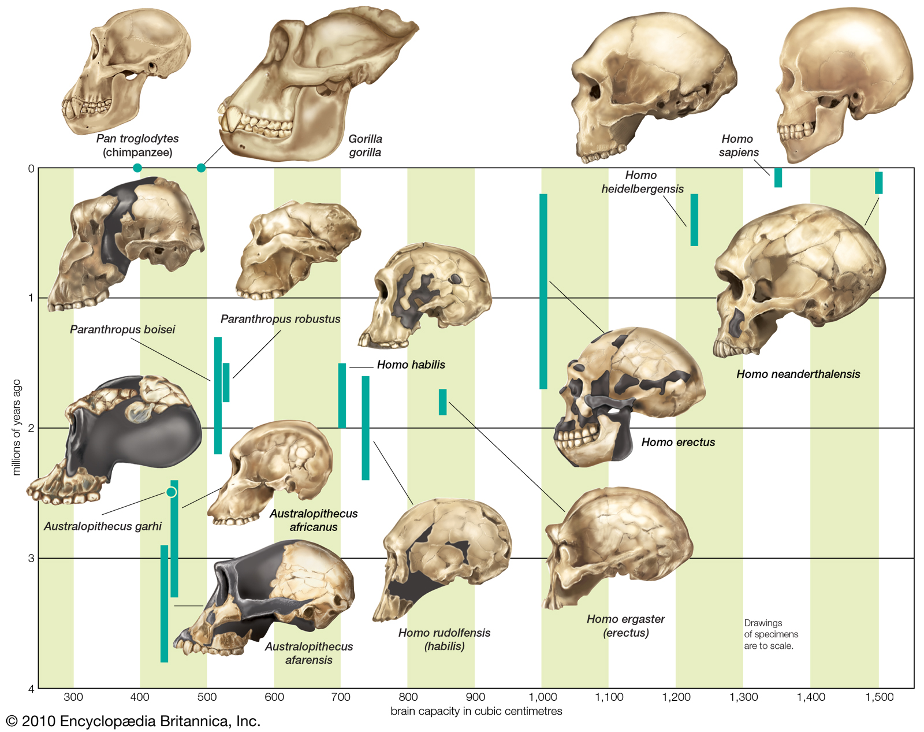
The Fossil Record of Human Evolution: Encyclopedia Britannica

Slide 8
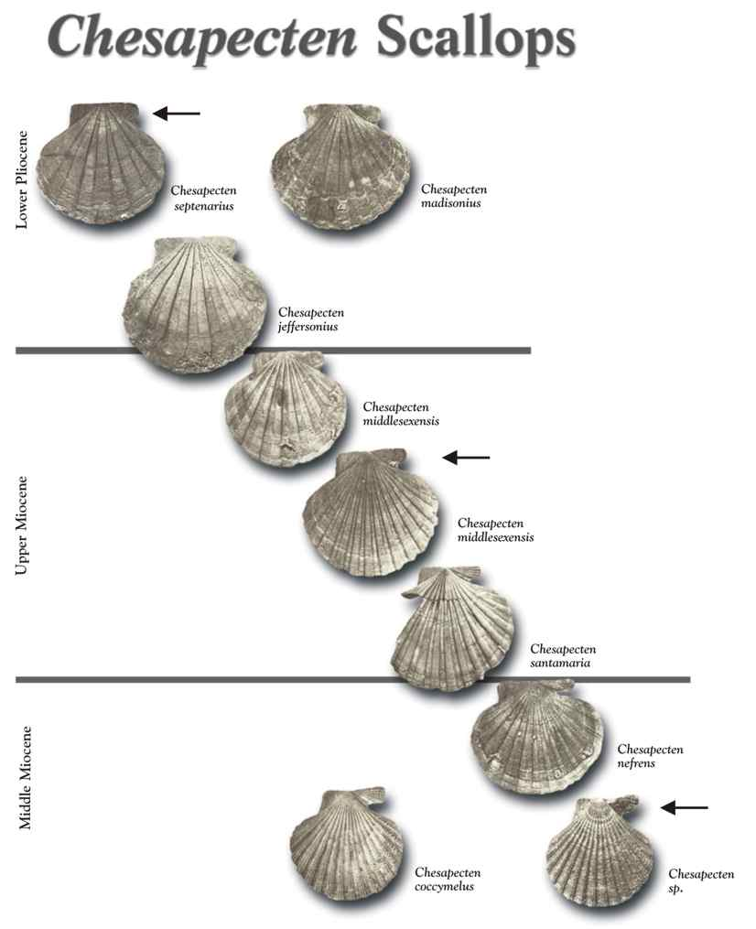
The Fossil Record

Slide 9
The Fossil Record
The argument goes…
If the fossil record shows continuous evidence of small changes in species, extinctions, and changes in the environment over geologic time…
Then this is evidence of evolution.

Slide 10
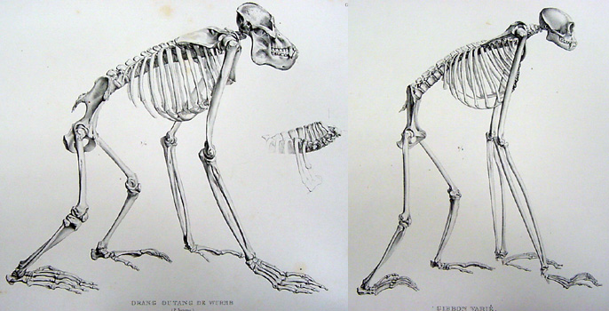
Comparative Anatomy

Slide 11
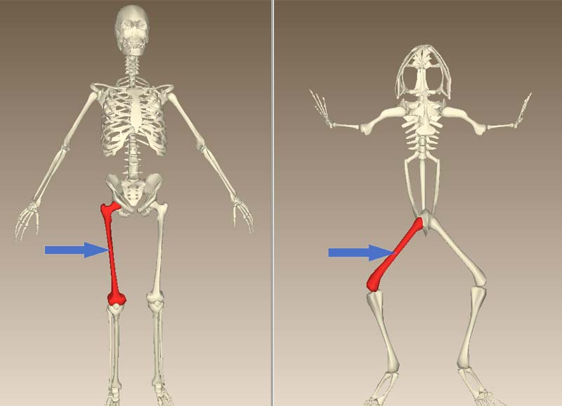
Comparative Anatomy

Slide 12
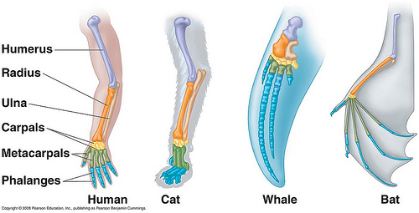
Comparative Anatomy

Slide 13
Comparative Anatomy
The argument goes…
If organisms have similar anatomy (bones… structures…)
Then they must be related by a Common Ancestor

Slide 14
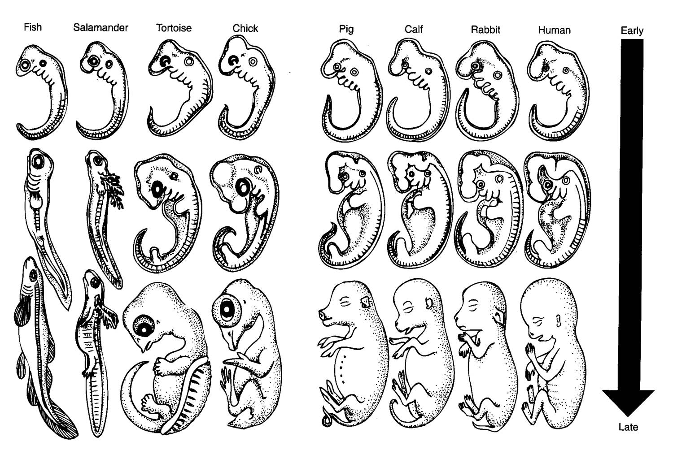
Embryology
What organisms do you think starts like this?

Slide 15
Embryology
What organisms do you think starts like this?

Slide 16
Embryology
What organisms do you think starts like this?

Slide 17
Embryology

Slide 18
Embrology
The argument goes…
If organisms have similar looking embryos (stage of early development)
Then they must be related by a Common Ancestor

Slide 19
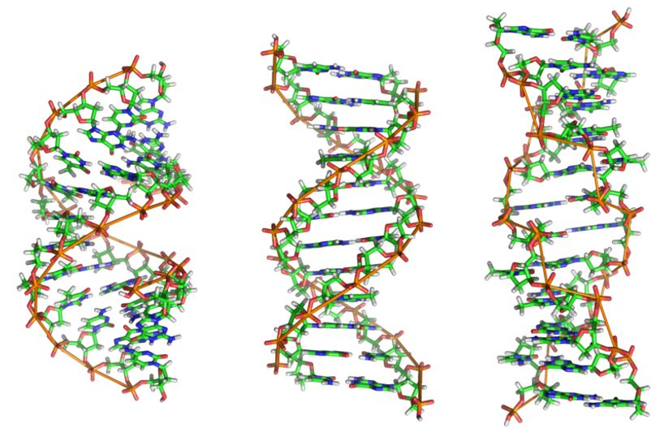
Comparative DNA
If the DNA is similar then they must be related by a
common ancestor.

Slide 20
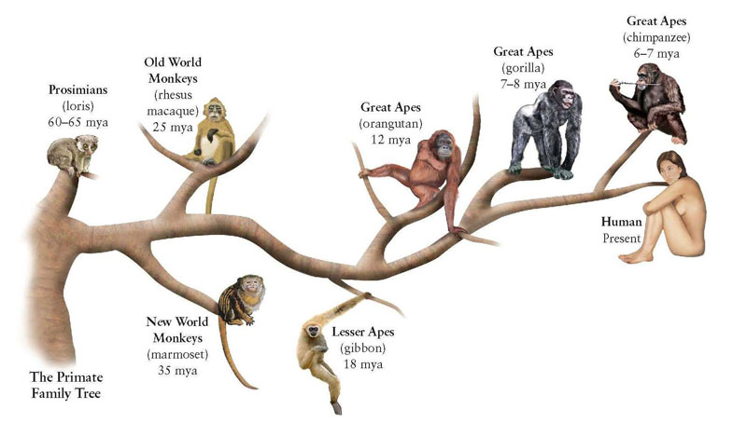
Branching Tree of Primates

Slide 21
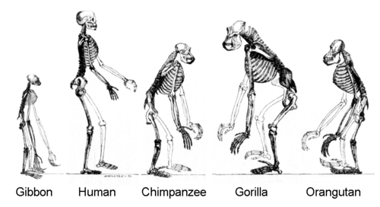
And here is what the bones look like…

Slide 22
The Fossil Record of Human Evolution: Encyclopedia Britannica

Slide 23
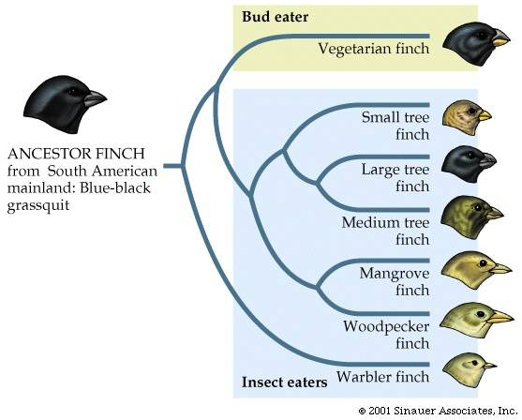
Branching Tree of Finches

Slide 24
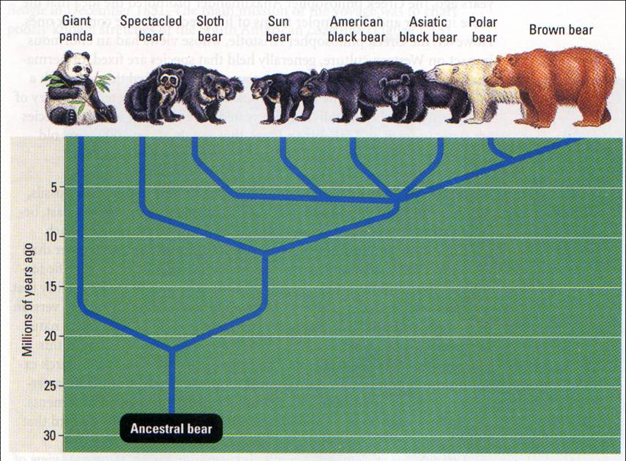
Branching Tree of Bears

Slide 25
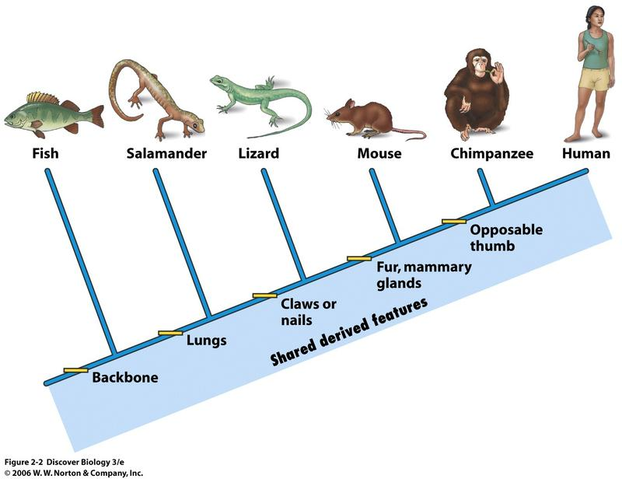
Simple Branching Tree of Life

Slide 26
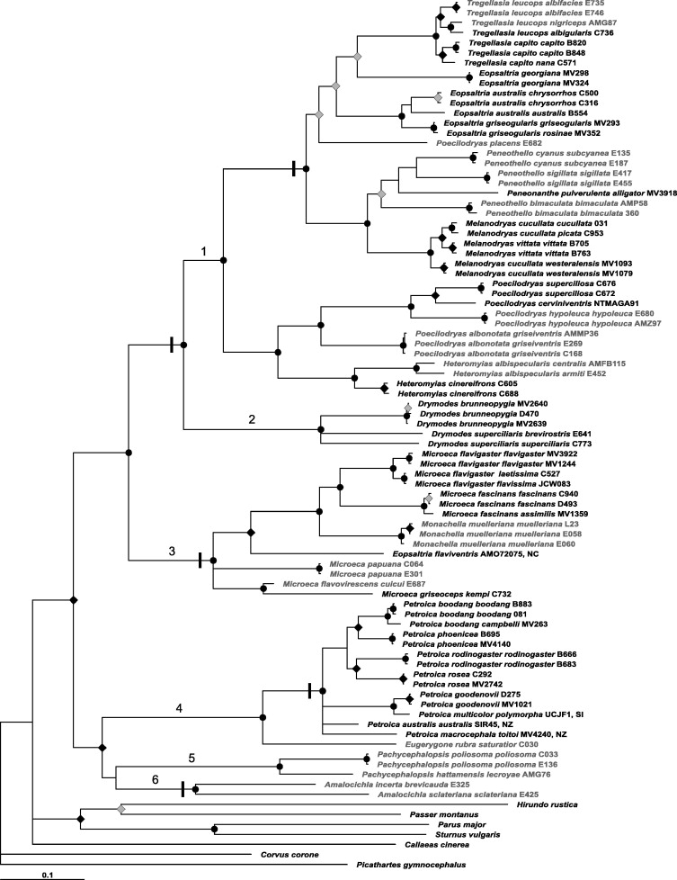
Complex Branching Tree of Life … and even this is incomplete … There are over 200 million species on Earth and we are all somewhere on the evolutionary tree of life branching off at different points

Slide 27
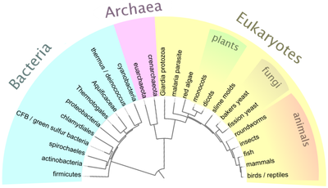
A Branching Tree of all of the Kingdoms of Life
Protists

Slide 28
Branching Tree
The argument goes:
When you combine all of the evidence for evolution the branching tree is a diagram that shows how scientists think different groups of organisms are related.

Slide 29
Do Now
← Take out your Evidence for Evolution Sheet
Today we will:
Finish the evidence notes on the Branching Tree
Complete a short lab with partners on Homologous Structures

Slide 30
7H Groups

