Slide 1
Plate Tectonics

Slide 2
Do Now
Find your puzzle pieces from yesterday and take them to a lab table.
You will assemble the pieces and glue them onto a piece of construction paper
At the top of the paper write Wegener’s Puzzling Evidence and your name.
Underneath the pieces you glued on, write your evidence for Pangaea

Slide 3
Wegener’s Puzzling Evidence

Slide 4
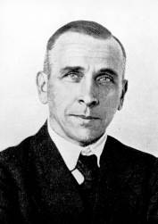
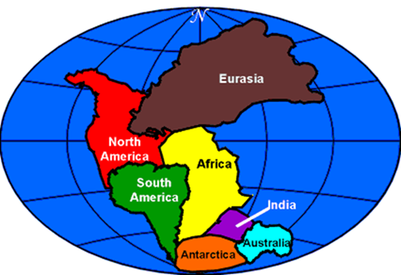
What was once called the theory of continental drift, (where it was thought that only the continents moved) is now the theory of plate tectonics where it includes the moving sea floor, too.
Alfred Wegener
(vay-guh-nur) hypothesized that the continents were once joined together as Pangaea 300 million years ago, and had drifted apart
What was his research
and evidence?

Slide 5
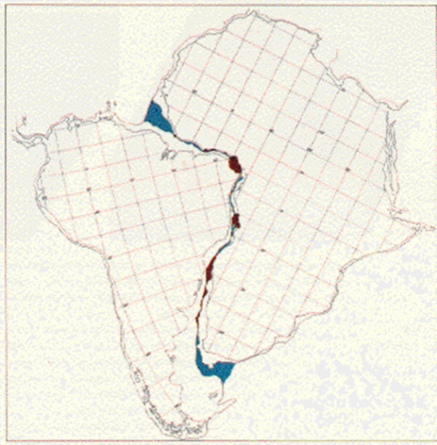
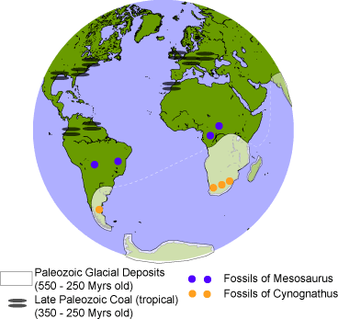
Wegener’s Info:
Land features:
continents fit together like a puzzle
with mountain ranges matching up on S. America & Africa
And coal fields matching up in Europe & N. America

Slide 6
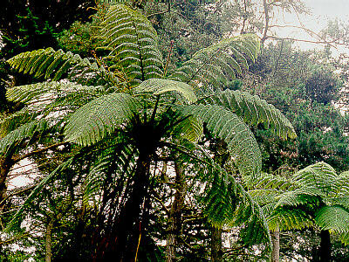
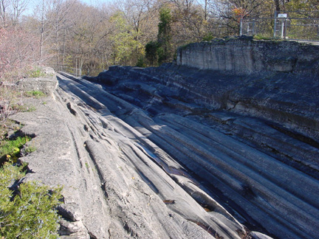
Climate Evidence: Fossils of tropical plants, similar to this fern, are found in cold areas on an island in the Arctic Ocean. Is it warm in the Arctic now?
Deep scratches in rock show that South Africa’s climate was once much colder as the area was covered in glaciers!
Are there glaciers in S. Africa now?

Slide 7
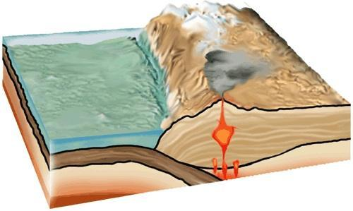
Remember the Lithosphere ?
It is made of the earth’s crust & the upper portion of the mantle.
This upper mantle is less dense than the mantle underneath, so it is able to “float” on the mantle below.
The mantle just below the lithosphere is called the Asthenosphere.
The asthenosphere has a plastic like, slowly flowing consistency, and it carries the lithosphere

Slide 8
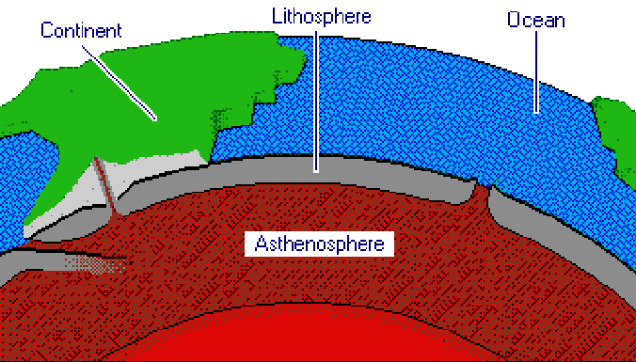

Slide 9
The Theory of Plate Tectonics
The Earth’s crust (lithosphere) is divided into 12 major plates which are moved in various directions.
This plate motion causes them to collide, pull apart, or scrape against each other.
Each type of interaction causes a characteristic set of Earth structures or “tectonic” features.
The word, tectonic, refers to the deformation of the crust as a consequence of plate interaction.
Notes:
There are 12 major plates on Earth, each of which slide around at a rate of centimetres per year, pulling away from, scraping against or crashing into each other.
Each type of interaction produces a characteristic “tectonic feature”, like mountain ranges, volcanoes and (or) rift valleys, that we will discuss during this lecture.

Slide 10
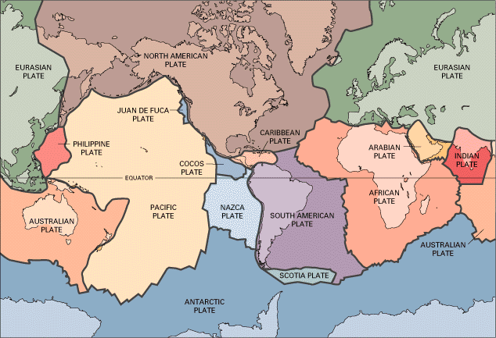
Lithospheric Plates
Notes:
This diagram shows the major Tectonic Plates.
Presenter: Point out the UK, sitting on the Eurasian Plate. Also the plate boundary between Africa and South America (note that it has the same shape as the coastlines in these countries).

Slide 11
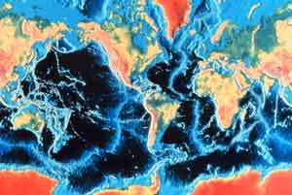
Oceanic and Continental Crust
Oceanic Crust is dense, thin, Basalt at the bottom of the ocean (3-5 miles thick)
Continental Crust is much thicker, Granite (10-25 miles thick)
- A Lithospheric Plate can be made up of one or both types of Crust

Slide 12
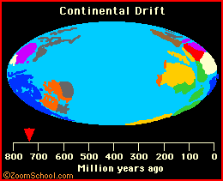
Lithospheric Plate Movement
Heat from the core causes Convection Currents in the mantle to move the lithospheric plates.
Movement of lithospheric plates is called Plate Tectonics

Slide 13
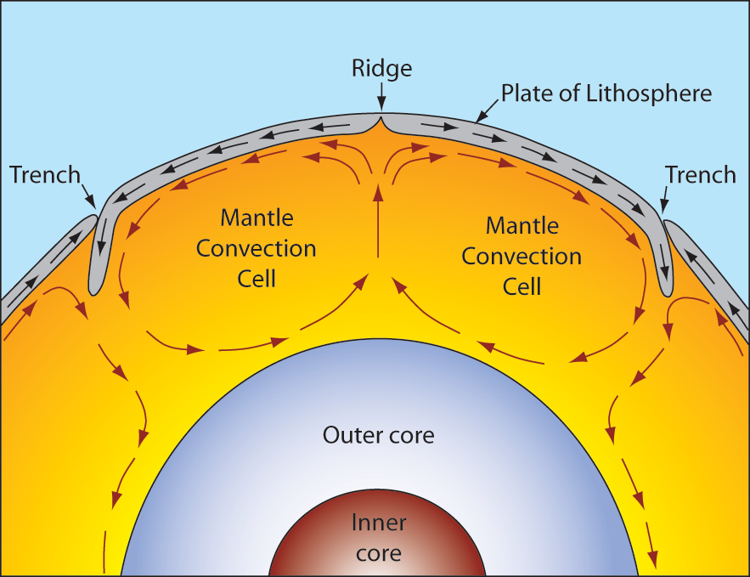
Plate Movement
“Plates” of lithosphere are moved around by the underlying hot mantle convection cells
Notes:
How and Why do tectonic Plates move around?
The question of how tectonic plates are moved around the globe is answered by understanding mantle convection cells.
In the mantle hot material rises towards the lithosphere (like hot air rising out of an open oven - ever opened an oven door and felt the blast of hot air coming past your face?). The hot material reaches the base of the lithosphere where it cools and sinks back down through the mantle. The cool material is replaced by more hot material, and so on forming a large “convection cell” (as pictured in the diagram).
This slow but incessant movement in the mantle causes the rigid tectonic plates to move (float) around the earth surface (at an equally slow rate).

Slide 14
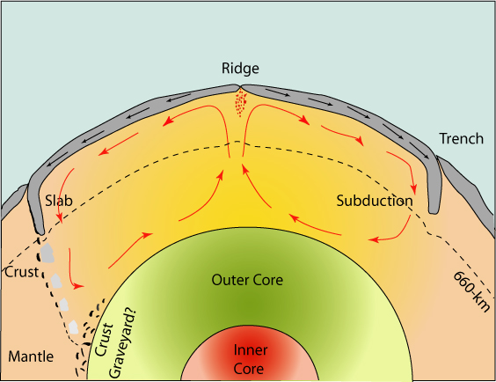

Slide 15
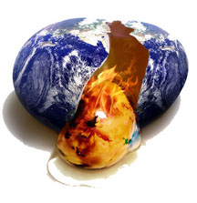
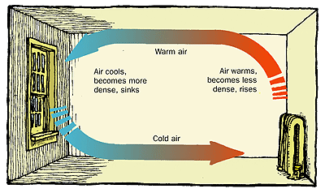
To understand how the lithospheric plates move we need to know how the core’s heat can warm the mantle and make it move Remember: Heat moves from a warmer area to a cooler area

Slide 16
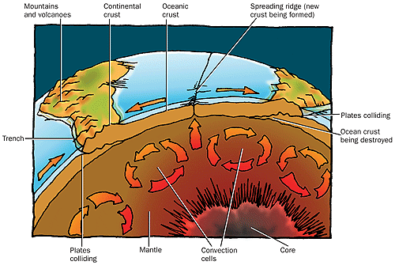
Convection Currents in the Mantle

Slide 17
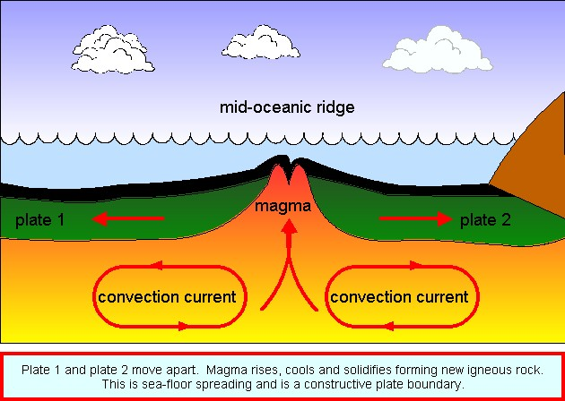
Sea-Floor Spreading
Not only do the continental plates move, but the oceanic plates move too.
Ocean areas where plates spread apart are called MID-OCEAN RIDGES.

Slide 18
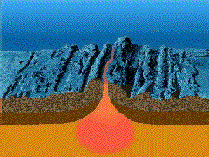
Here’s what you might see if the process of sea-floor spreading was sped up…

Slide 19
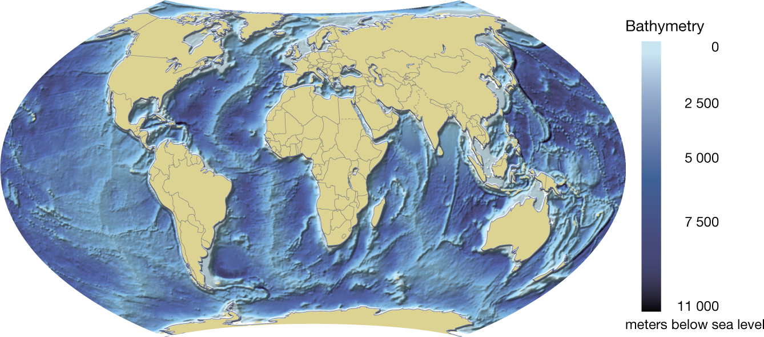
Mid-Ocean Ridges

Slide 20
Mid-Ocean Ridges are found winding around the Earth in all oceans.
They look like mountain ranges.
Most stay under the surface of the water.
Iceland is one area of the mountain range that rises above the surface of the North Atlantic Ocean
What happens when plates move apart??? Magma/lava rises up!

Slide 21
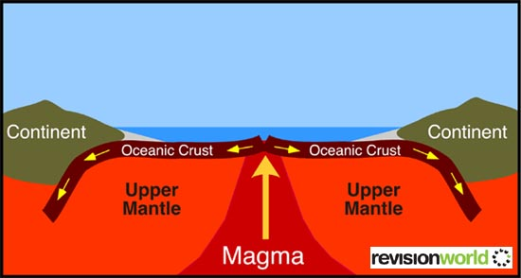
Sea Floor Spreading Song:
We start in the Mantle as molten magma. Hands together clap:
Call Response
Magma rises up to the mid ocean ridge
(hands go up together)
Spreads out – sea floor spreading
(Hands separate)
Subducts down into the trenches
(Hands go down)
Melts back into the Mantle
(Hands wave in front of you to show melting)

Slide 22
What happens at tectonic plate boundaries?
Notes:
We are now going to discuss the processes that occur at plate tectonic boundaries. What happens when plates meet?

Slide 23
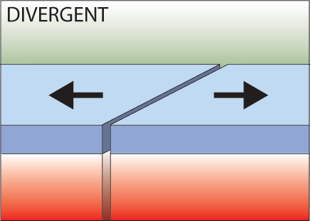
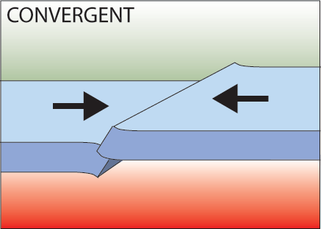
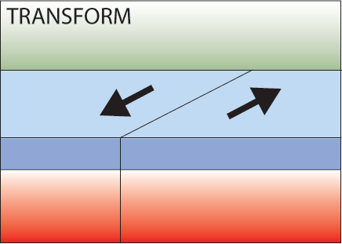
Three types of plate boundary
Divergent
Convergent
Transform
Notes:
Firstly, there are three types of plate boundary, each related to the movement seen along the boundary.
Divergent boundaries are where plates move away from each other
Convergent boundaries are where the plates move towards each other
Transform boundaries are where the plates slide past each other.
Presenter: See diagrams for each - it is important to remember the names of the boundary types and the motion involved.

Slide 24
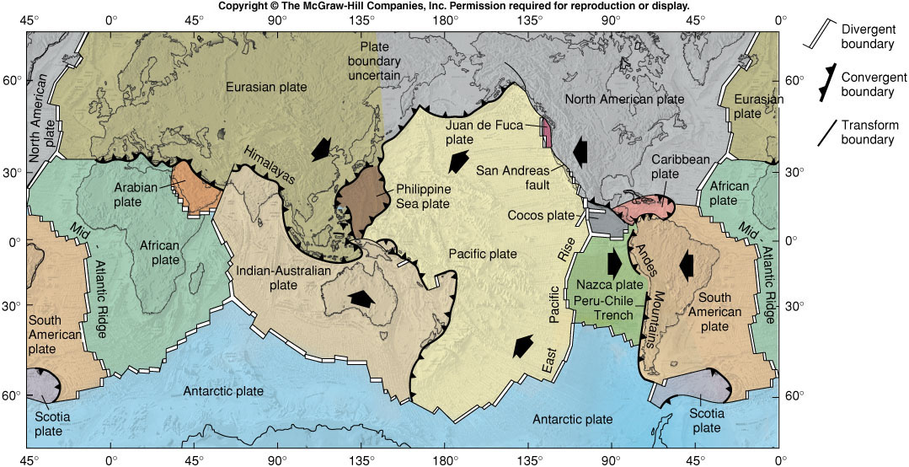
Boundary Types

