Slide 1
Your Science Notebook
Turn to the First Page in your Notebook
If you have already written on it, erase the writing…
If it is in pen, please ask for a piece of paper to cover it…
DO NOT RIP OUT PAGES!!!
Please make your first page look like the example →
7th Grade
Life Science
Journal
Your Name
2013 - 2014

Slide 2
Scientific Method Notes
Ms. Aeschlimann
6th and 7th Grade Science
September 2013
Scientific Method 9/11/13

Slide 3
The Scientific Method
A step-by-step procedure for
scientific problem solving
Scientific Method 9/11/13
A step-by-step procedure for
scientific problem solving

Slide 4
Why do we use the scientific method?

Slide 5
Why use the Scientific Method ?
A clear order of steps like a recipe that scientists use to come to figure things out about the world around them.
Helps to organize thoughts and procedures so that scientists can be confident in the answers they find.
Way to communicate results effectively

Slide 6
Steps of the Scientific Method :
1. Observe
2. Question
3. Hypothesis
4. Experiment
5. Analysis
6. Conclusion
7. Communicate

Slide 7
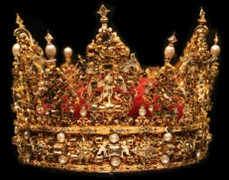
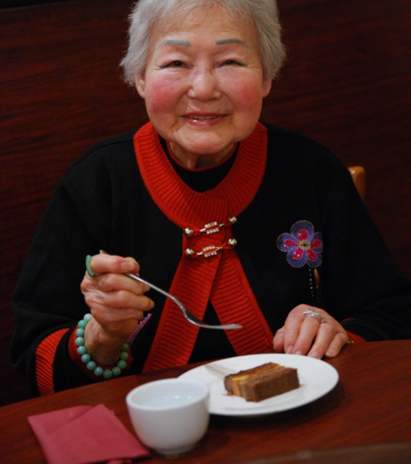
Remember:
Observe
Question
Hypothesis
Experiment
Analysis
Conclusion
Communicate
Old
Queen
Holly
Eats
Amazing
Chocolate
Cake

Slide 8
Observe
Information gathered through your senses.
Sight, smell, touch, hear, taste*
*We never taste anything in the lab!
A scientist notices things in their natural world

Slide 9
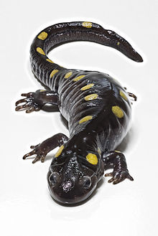
Observe
An example of an observation might be noticing that many salamanders near a pond have curved tails, not straight tails.

Slide 10
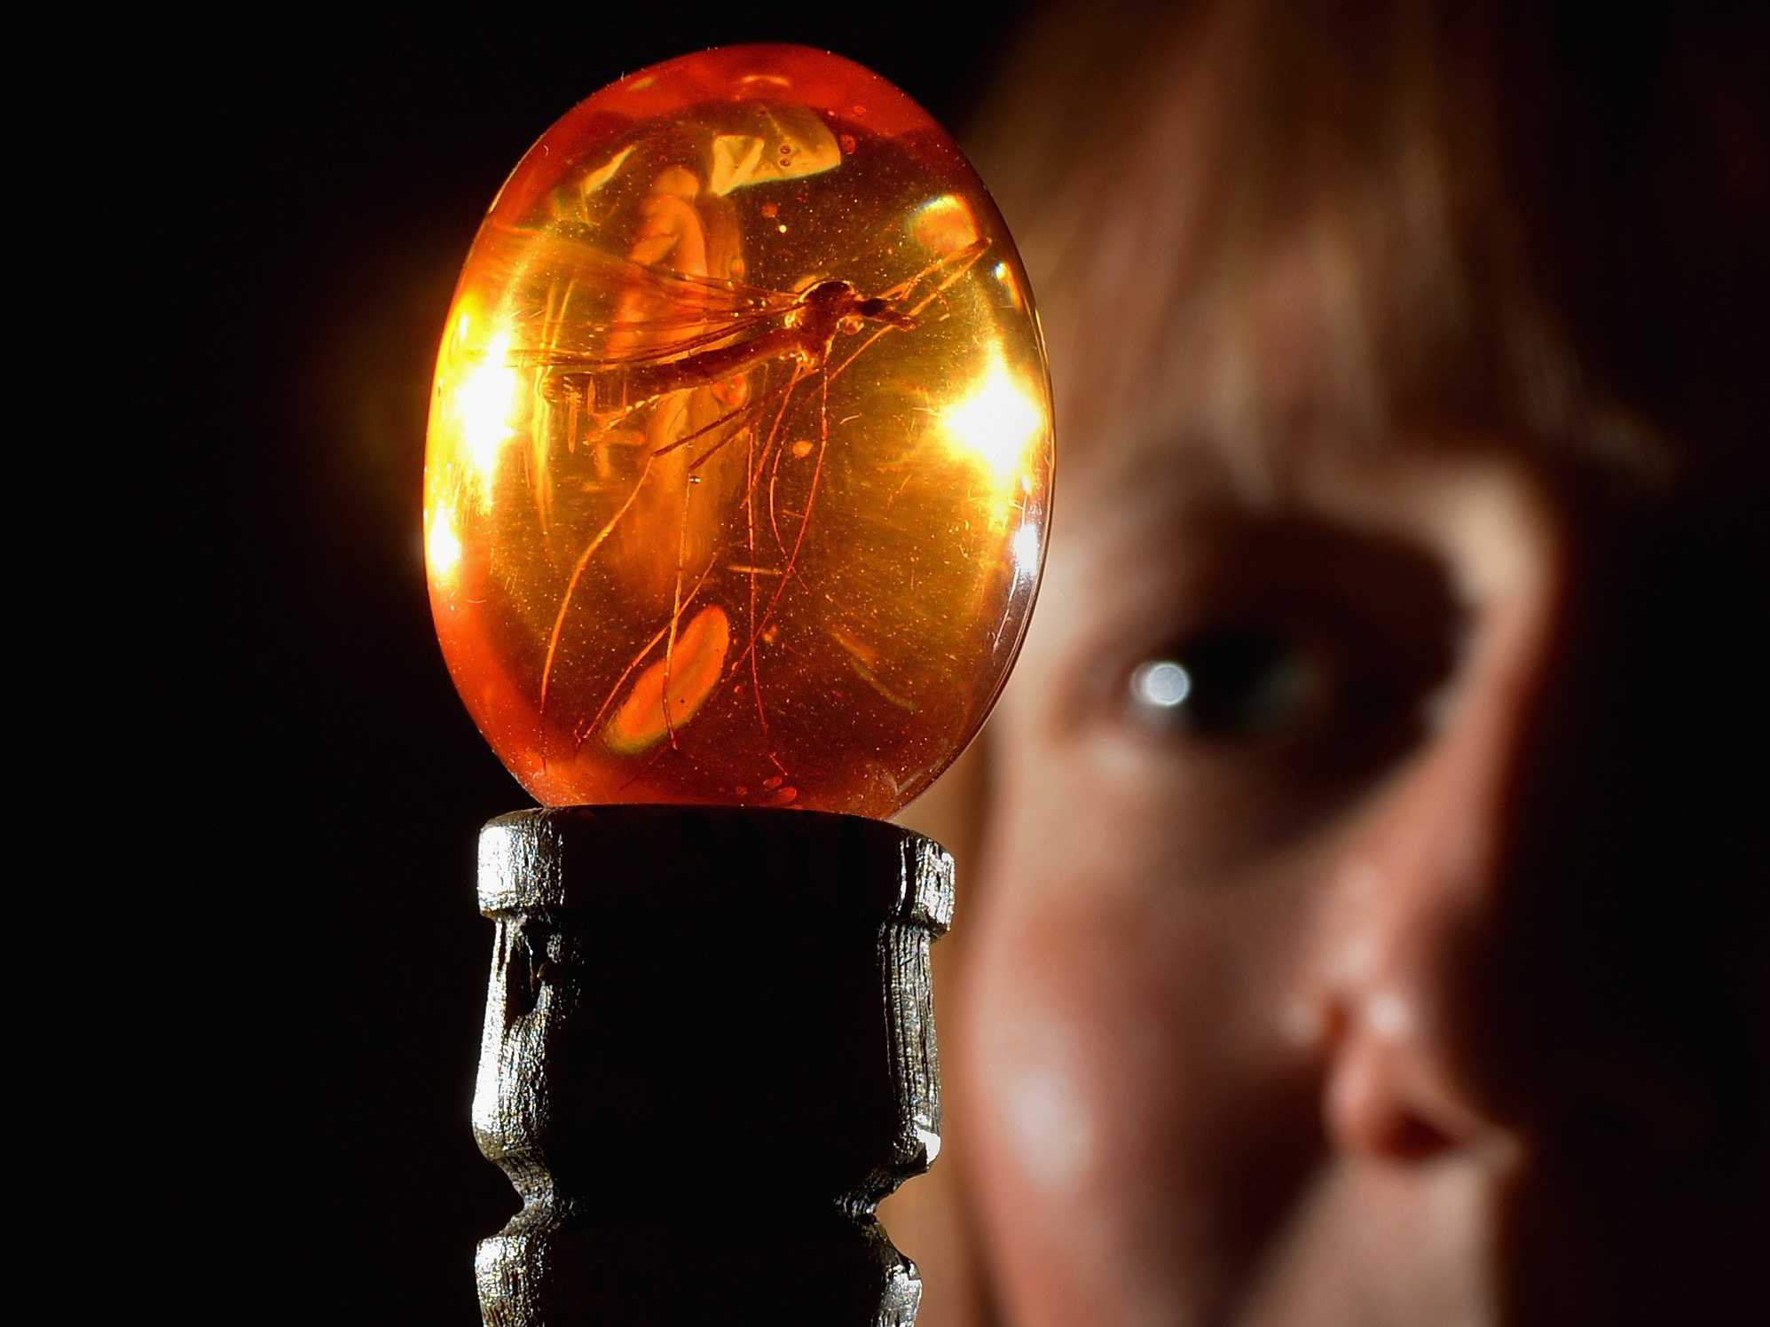
Question
Problem you are trying to solve
This comes from your observations of the natural world.

Slide 11
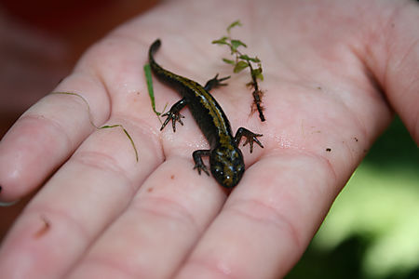
Question
Good Question:
Why do the salamanders around here have curved tails rather than straight tails?
Not So Good Question:
I wonder if salamanders like McDonalds?

Slide 12
Hypothesis
A suggested solution to the problem.
Must be testable with measurable results
Sometimes written as If…Then… statements
Predicts an outcome

Slide 13
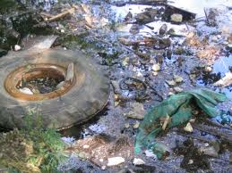
Hypothesis
An example of a hypothesis might be that the salamanders have curved tails due to a pollutant in the moist soil where they live.

Slide 14
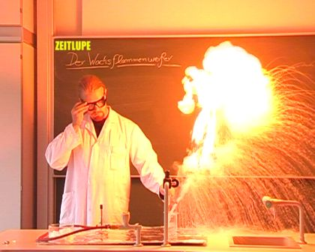
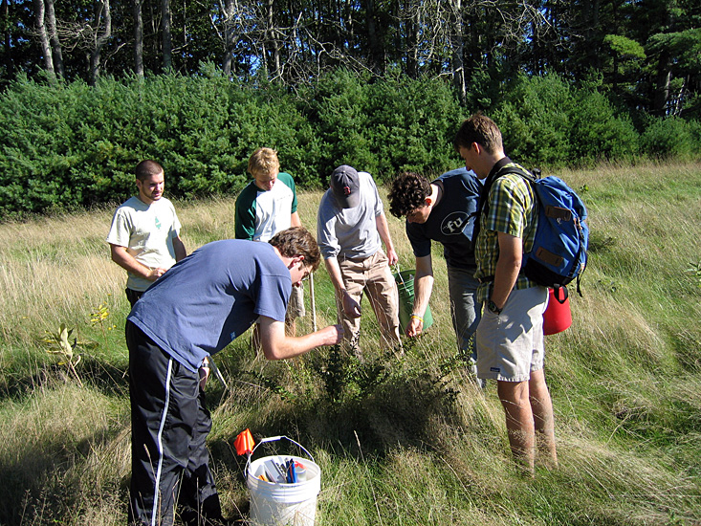
Experiment
A procedure to test your hypothesis

Slide 15
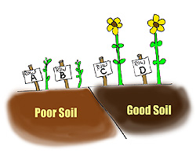
Experiment
Variable – factor in the experiment that is being tested

Slide 16
Why is it important to test only one variable at a time?

Slide 17
Experiment
A good or “valid” experiment will only have ONE variable
An experimenter changes one variable and observes or measures what happens.
We will talk more about variables later…

Slide 18
Analysis
Data is the information collected during the experiment.
Data should be organized in the form of a chart, table, or a graph

Slide 19
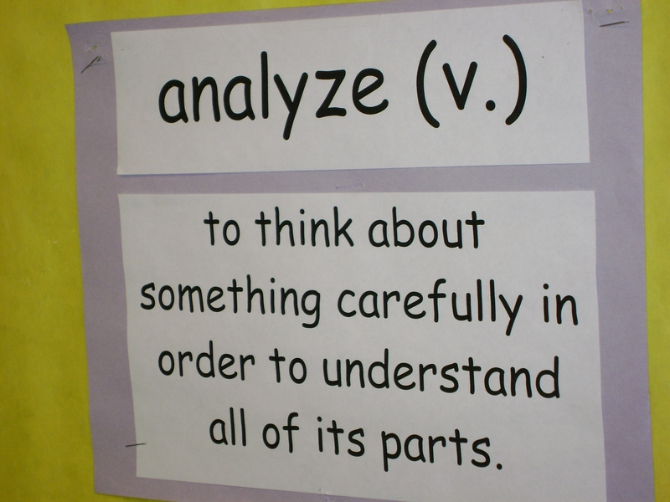
Analysis
To “analyze” the data means to
“make sense” of the data.

Slide 20
Conclusion
The answer to the hypothesis based on the data obtained from the experiment
Explains how experiment can be applied to real life.

Slide 21
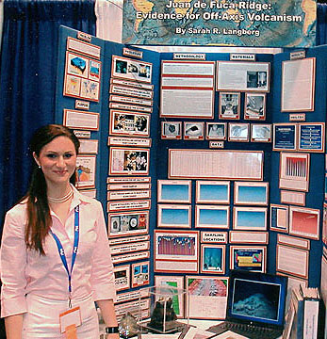
Communicate
Every experiment adds to the world’s scientific knowledge.
Communicating your results in the form of a report or presentation gives other scientists a chance to review your work and build on it.

Slide 22
Remember:
Observe
Question
Hypothesis
Experiment
Analysis
Conclusion
Communicate
Old
Queen
Holly
Eats
Amazing
Chocolate
Cake

Slide 23
Scientific Method Song
http://msascienceonline.weebly.com/scientific-method.html

Slide 24
Pop Quiz
Put your full Name and Date on the top of the paper.
List the 7 steps of the Scientific Method in order

Slide 25
Controls and Variables

Slide 26
Scientific Experiments Follow Rules
An experimenter changes one factor and observes or measures what happens.

Slide 27
The Control Variable
The experimenter makes a special effort to keep other factors constant so that they will not effect the outcome.
Those factors are called control variables.

Slide 28
What is the Purpose of a Control?
Controls are NOT being tested
Controls are used for COMPARISON

Slide 29
Other Variables
The factor that is changed is known as the independent variable.
The factor that is measured or observed is called the dependent variable.

Slide 30
Example of Controls & Variables
For example, suppose you want to figure out the fastest route to walk home from school.
You will try several different routes and time how long it takes you to get home by each one.
Since you are only interested in finding a route that is fastest for you, you will do the walking yourself.

Slide 31
What are the Variables in Your Experiment?
Varying the route is the independent variable
The time it takes is the dependent variable
Keeping the same walker throughout makes the walker a control variable.

Slide 32
One more thing… it is best to make several trials with each independent variable.

Slide 33
Valid Experiments

Slide 34
Remember: To be a Valid Experiment:
Two groups are required --- the control & experimental groups
There should be only one variable

Slide 35
Data
Results of the experiment
May be quantitative (numbers) or qualitative

Slide 36
Data
Must be organized
Can be organized into charts, tables, or graphs

Slide 37
Conclusion
The answer to the hypothesis based on the data obtained from the experiment

Slide 38
Retest
In order to verify the results, experiments must be retested.

Slide 39
Review

Slide 40
Solving a Problem
1)Identify a Problem
2) State Observations about the problem
3) Form a Hypothesis about the problem (if…then…)
4) Design an Experiment to test the hypothesis
5) Collect Data
6) Form a Conclusion
7) Retest

